Slide 1
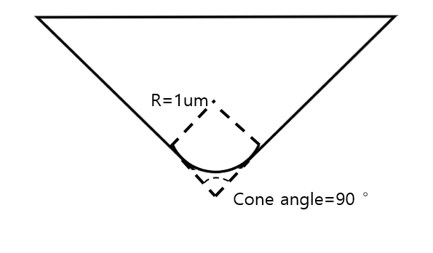
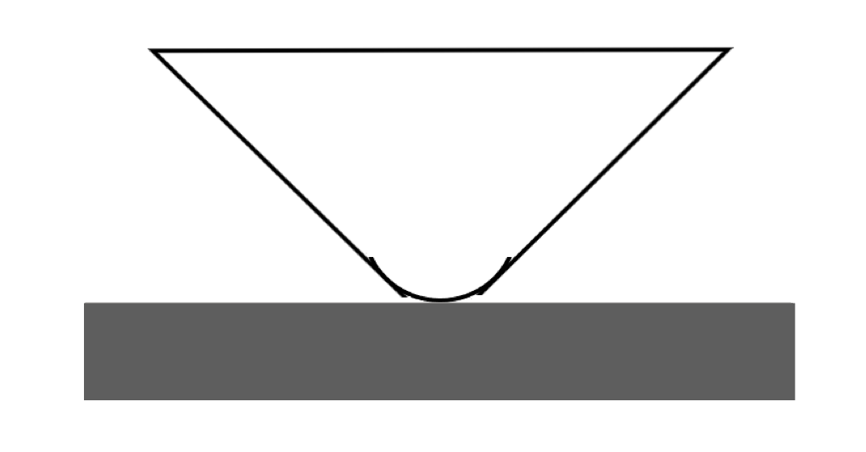

Indenter
Indenter radius: 1um
Cone Angle: 90°
Indenter
Grain
1

Slide 2
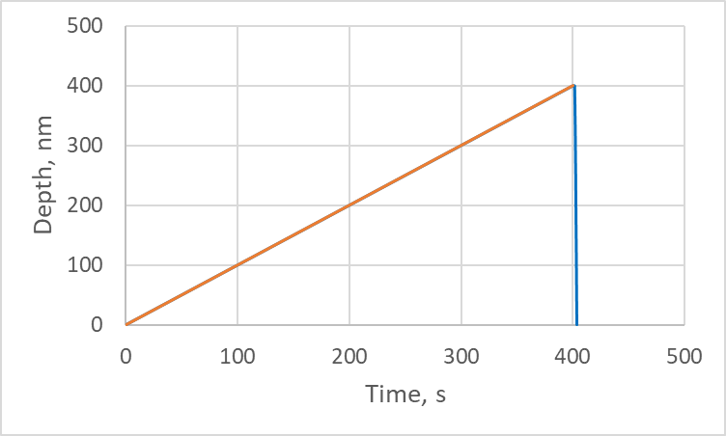
Loading function - Example
Total time: 407 s
Total penetration depth: 400 nm
Loading time: 400 s
Loading rate: 1nm/s
Holding time: 2 s
Unloading time: 5 s
Holding
Loading
Unloading
2

Slide 3
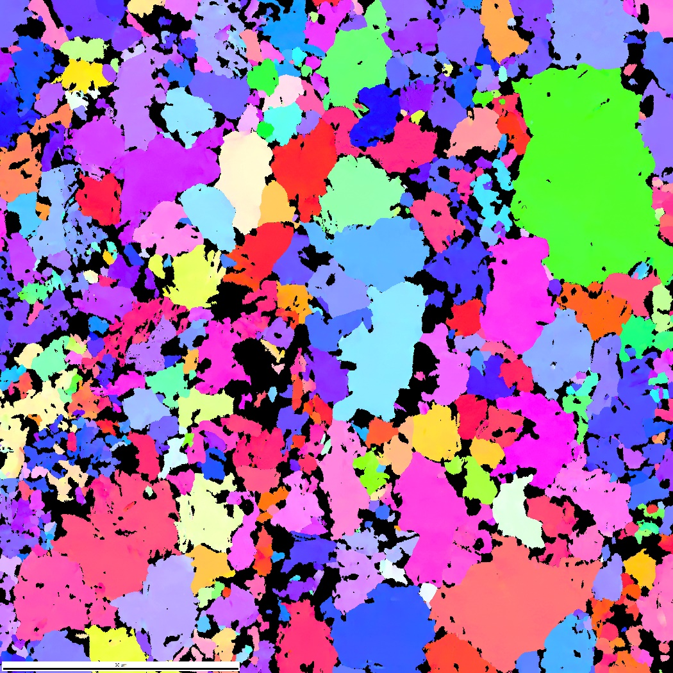
Position
Green
Blue
Red
3

Slide 4
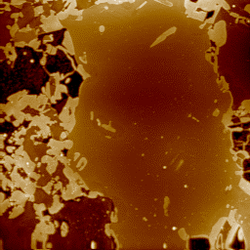
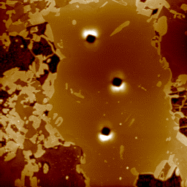
Green grain
Before test
After test
1
2
5um
5um
4

Slide 5
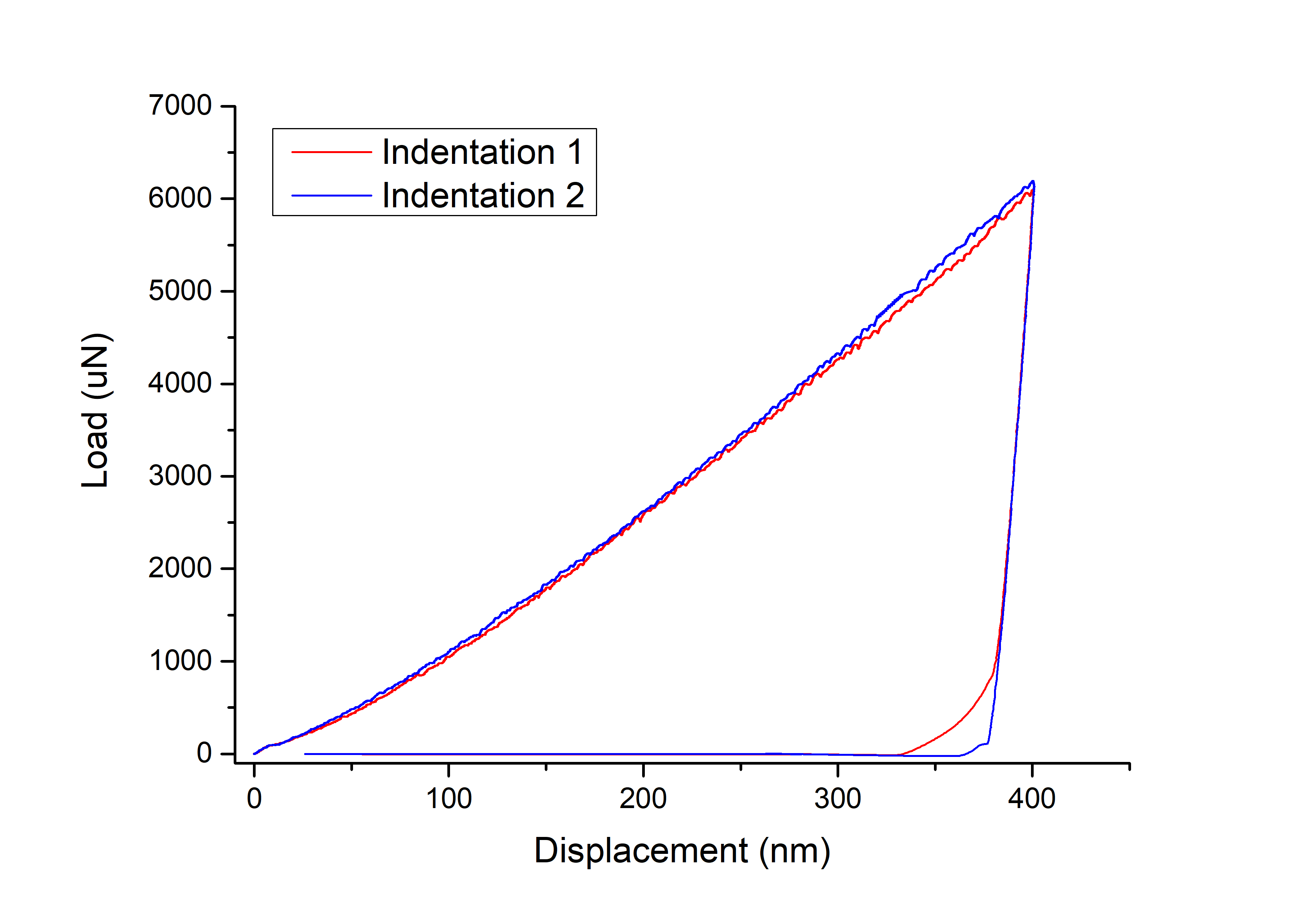
Green grain
1
2
3
4
5

Slide 6
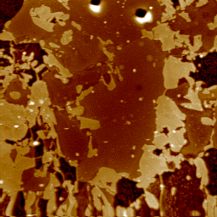
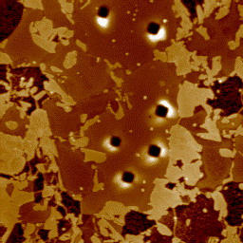
Blue grain
Before test
After test
1
2
5um
5um
6

Slide 7
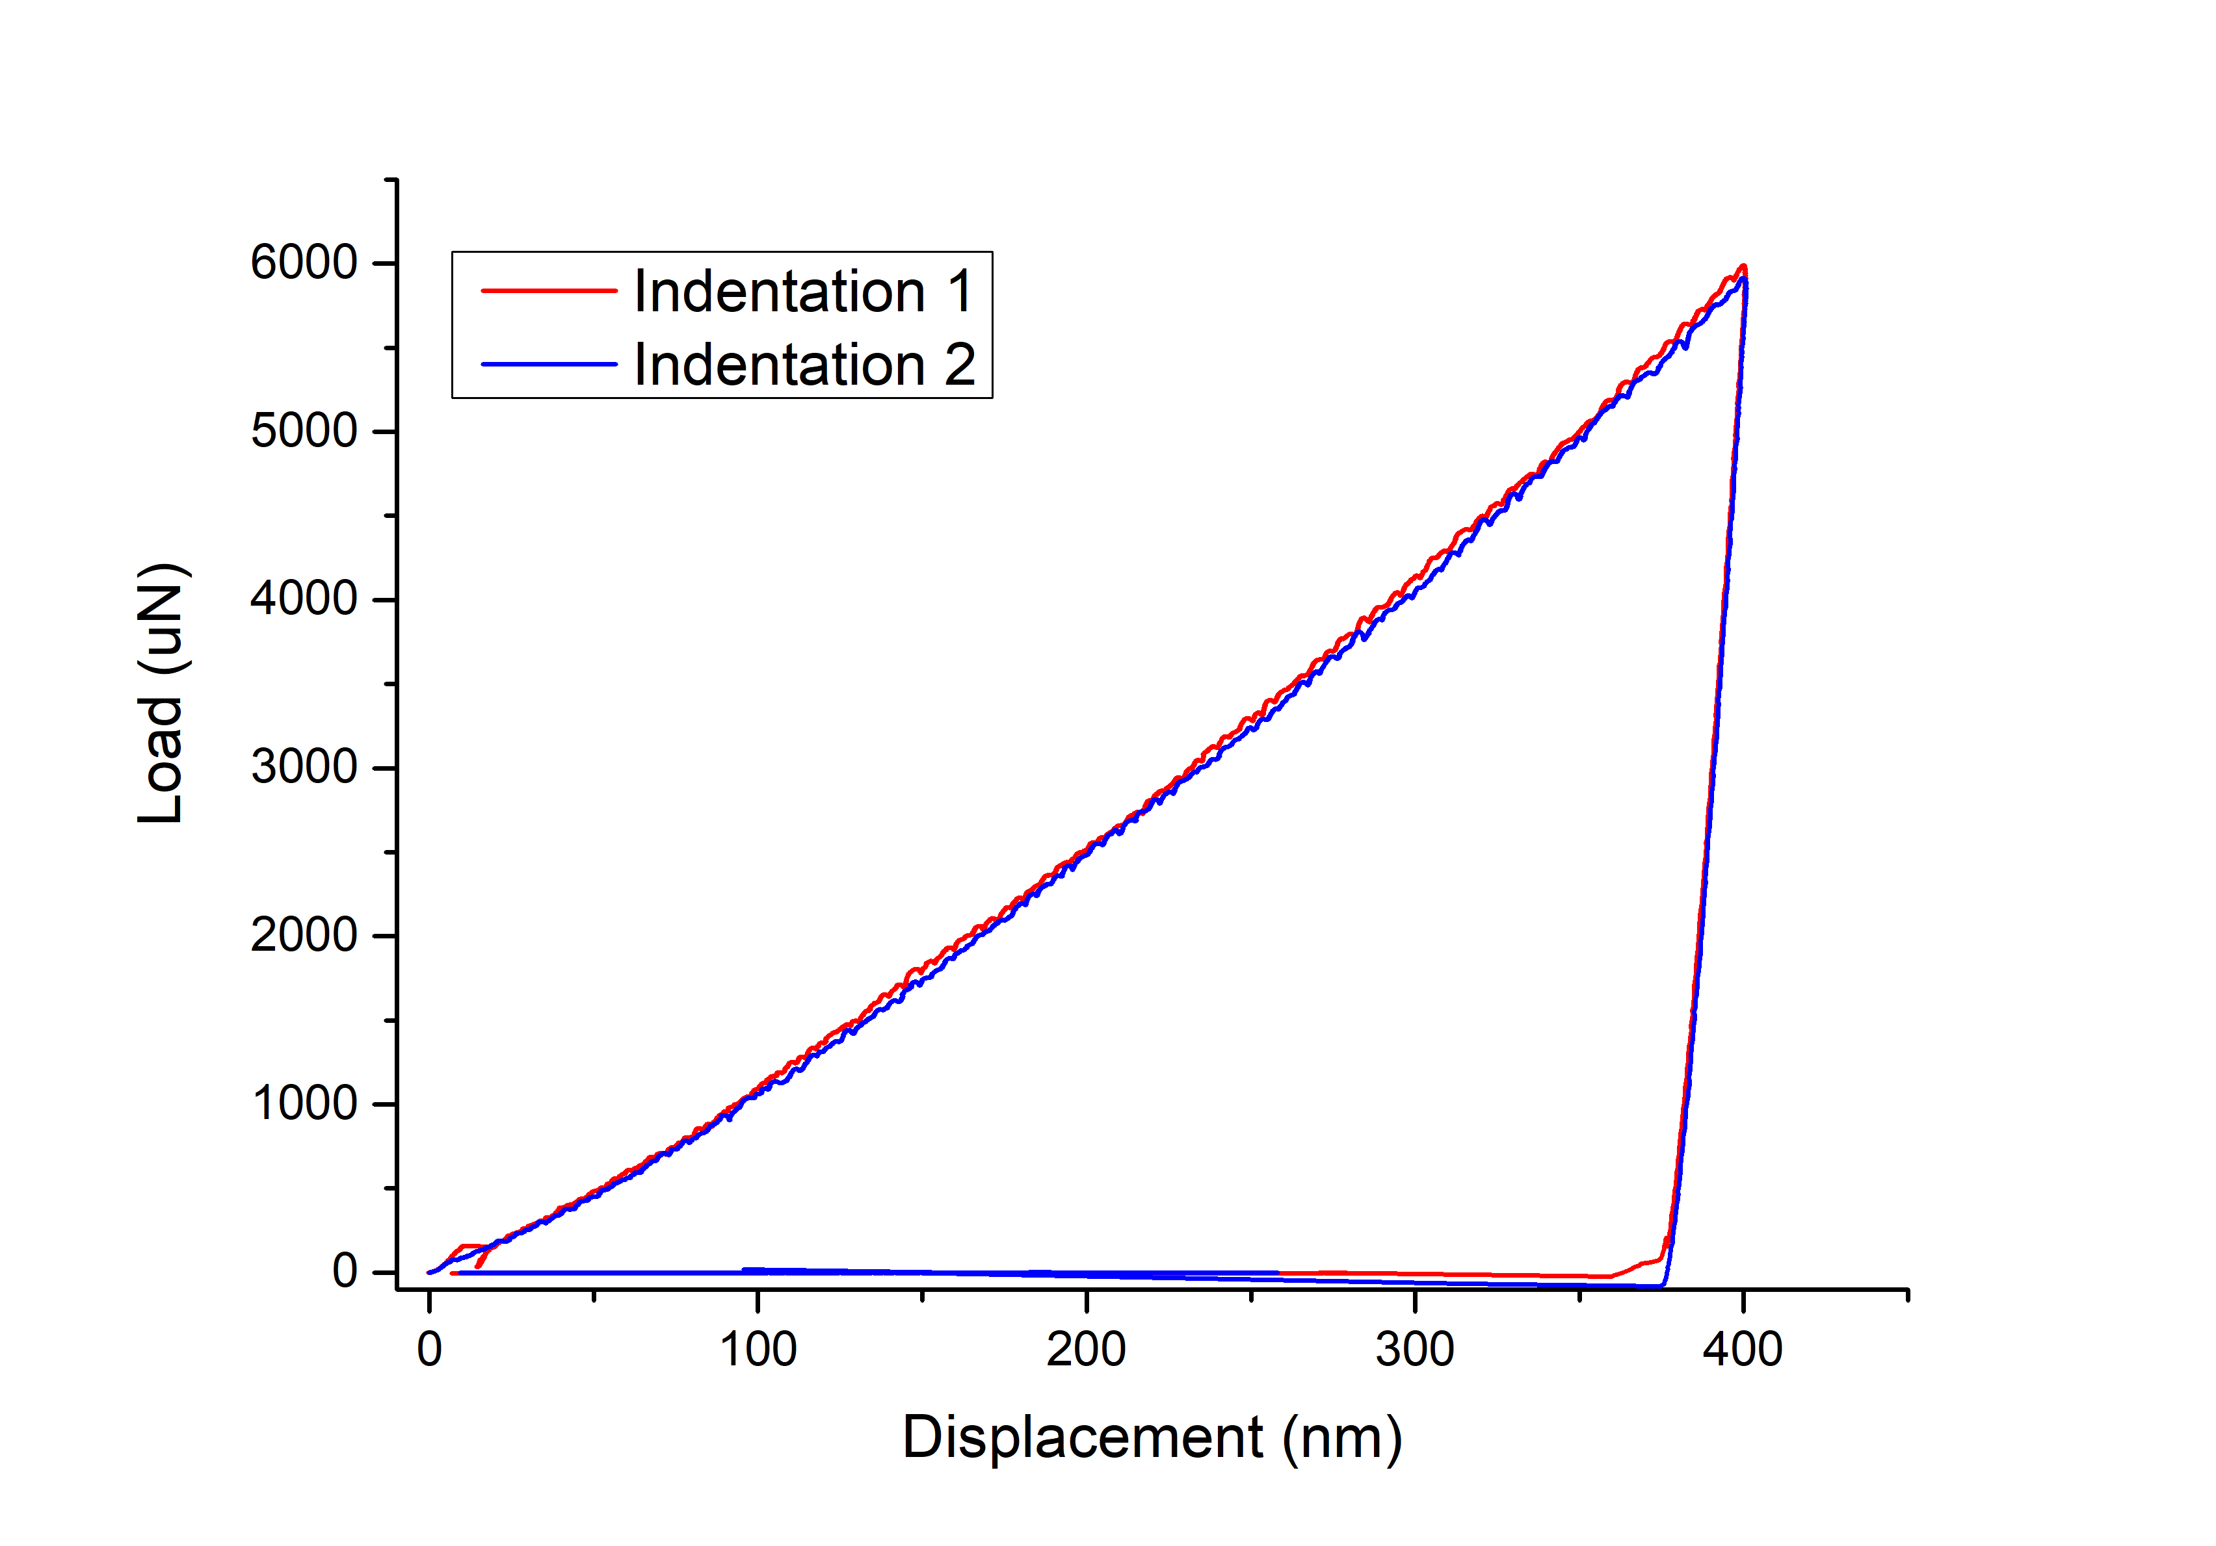
Blue grain
1
2
3
4
7

Slide 8
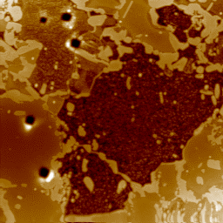
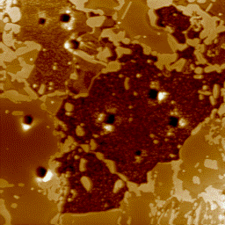
Red grain
Before test
After test
1
2
5um
5um
8

Slide 9
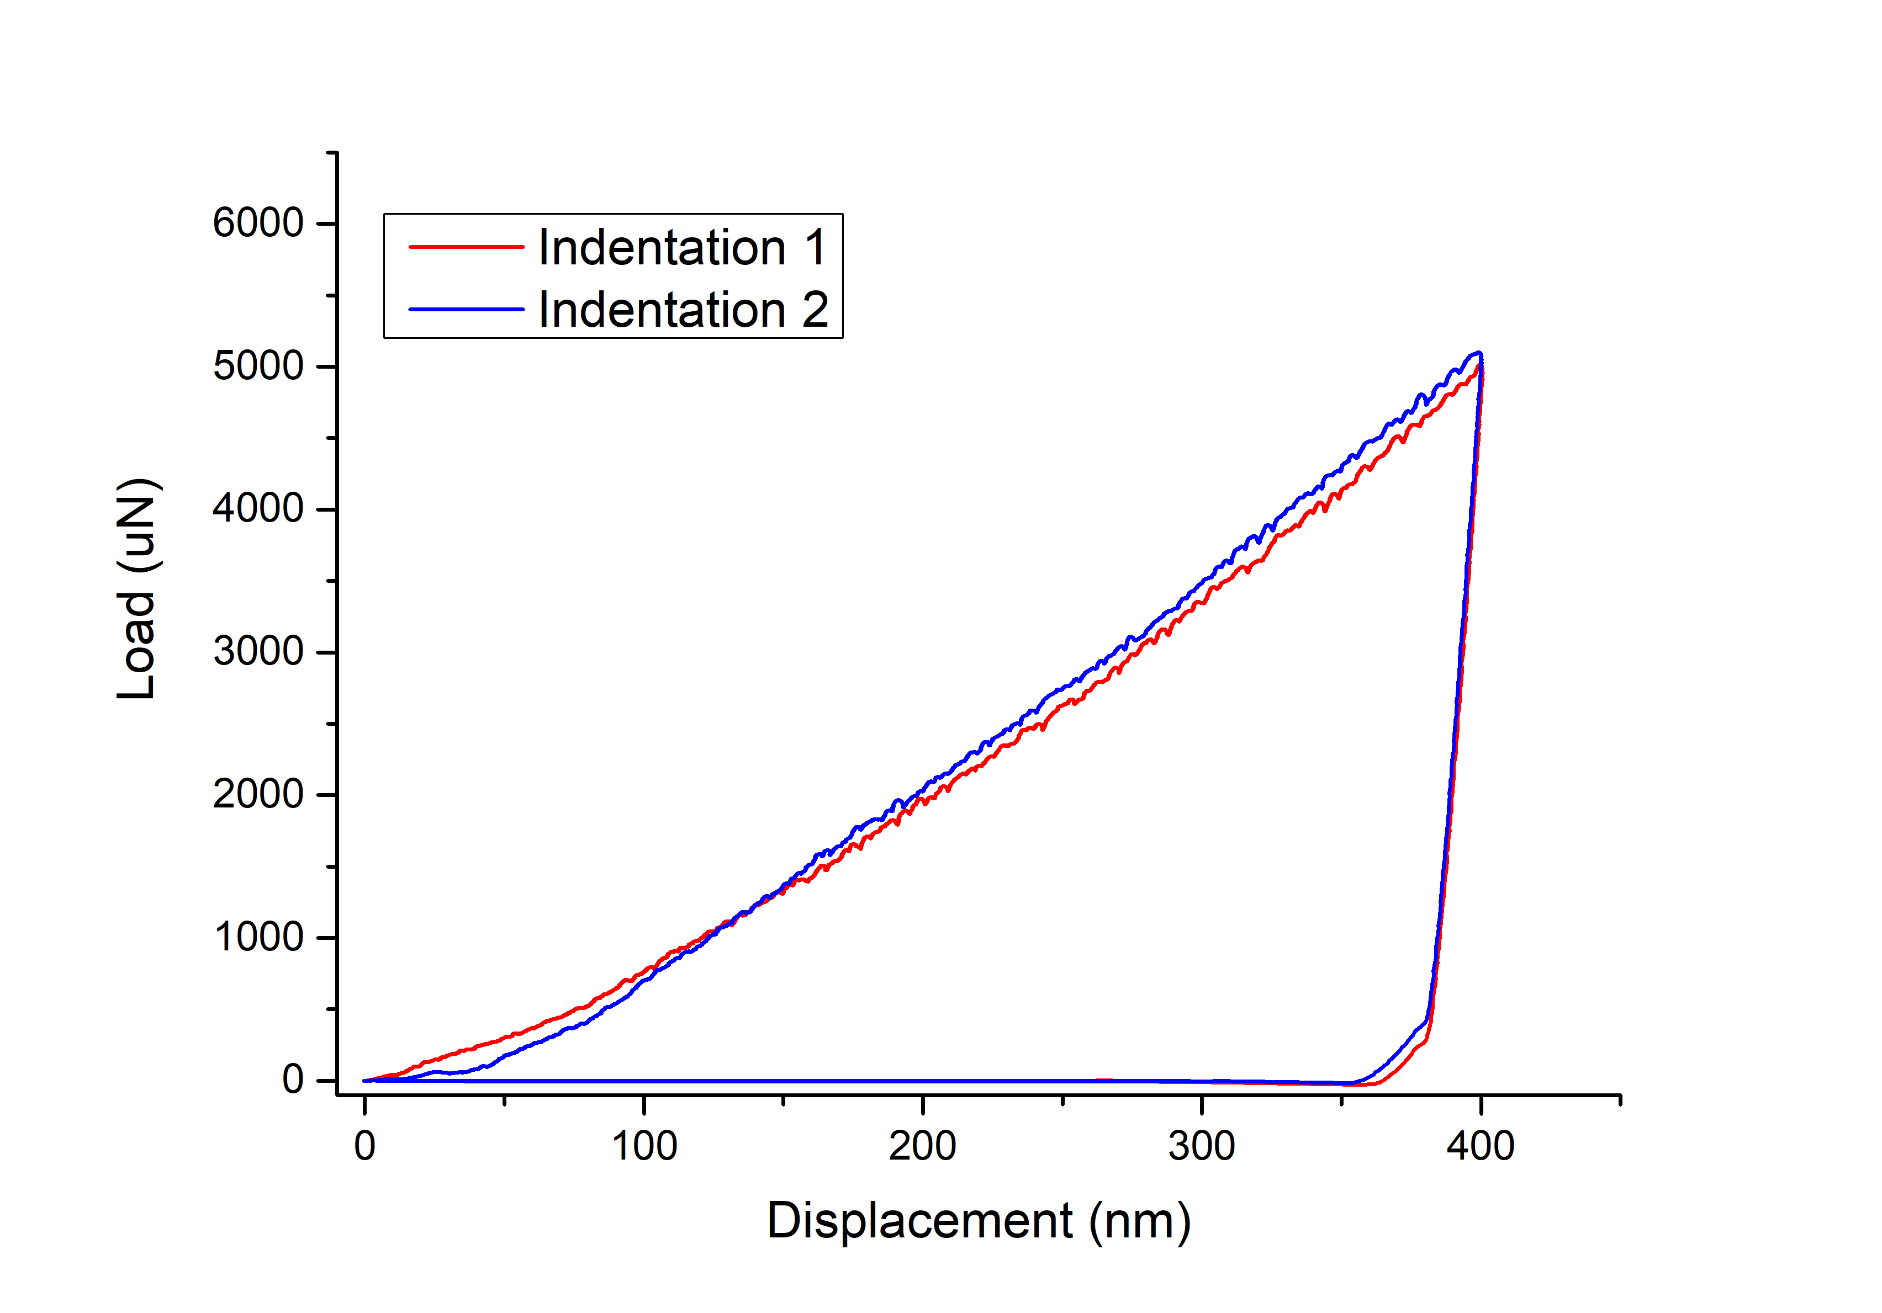
Red grain
1
2
2
3
1
4
5um
5um
5um
5um
9

